Slide 1
A graphical Approach for Personal Shopping Guide in Post Covid World Name – JAGNANI REYAAN SUMIT MIS – 112015066 Project Supervisor – Dr. Bhupendra Singh

Slide 2
Problem Statement Overview
Why this?
No Similar Tool Present in the Market
Difficulty to take care of multiple parameters before going for shopping.
Extremely important to curb the spread of the viruses and diseases in post-covid world.
What is our ultimate purpose?
Limiting Travel and Disease Spread
Dependent Route Scheduling
Cost Minimization
Monitoring and Controlling Crowd Density

Slide 3
Which area should we focus on and why?
Graph Theory and its applications such as Dijkstra’s Algorithm, Kruskal’s Algorithm, Disjoint Set Union, Travelling Salesman Problem Algorithm and Minimum Spanning Tree Algorithm.
Real Time Weather and Crowd Prediction Techniques.
Pruning Techniques

Slide 4
This is the method I would like to propose!!

Slide 5
Methodology
The Algorithms I planned to use and why
Dijkstra’s Algorithm – To get the shortest paths in labelled graphs.
Minimum Spanning Tree and Disjoint Set Union – To remove extra and unwanted edges from the graph.
Travelling Salesman Problem – To find the most optimal path to get started from a certain node and visit all the necessary nodes and get back to the starting node.

Slide 6
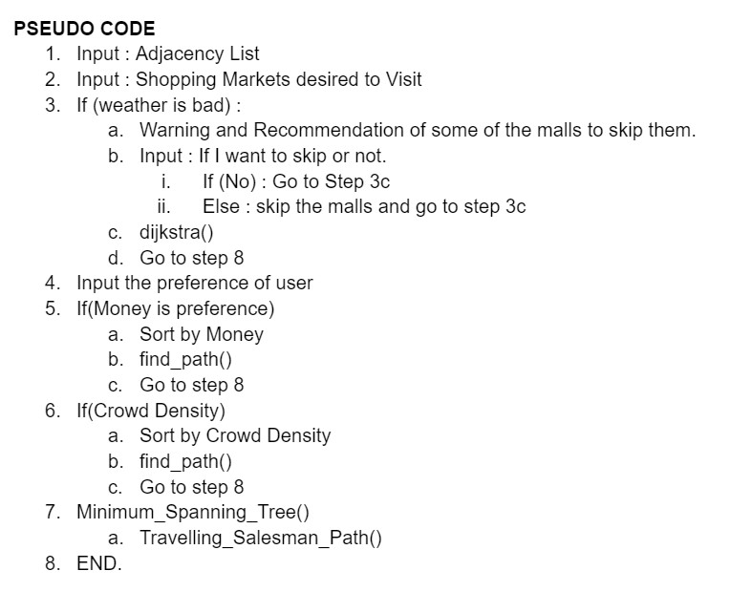
My Proposed Solution

Slide 7
Conclusion
While the current effort prioritizes the COVID scenario, algorithms such as Dijkstra, Kruskal, and DSU have no bounds and can be employed in complicated mall networks with nearly any level of load.
During the post-covid era, the social distancing will be an important phase of our life and less crowded areas will be preferred over densely crowded areas.

Slide 8
But the work isn’t done yet
Although we have implemented a fairly optimal solution, once the application goes to large scale, some additions and improvements will be beneficial.
We can use some famous machine learning models to predict the crowd density according to a specific time and we can simulate it according to the current time.
The project can be fine-tuned to place a greater emphasis on strategically and geographically significant regions.

Slide 9
References
Use Of Graph Theory in transportation problems and different networks. Ms. Ch Sai Harikam, Ms. D Anusha. Jorunal of Applied Science and Computations Volume V, Issue XII, December/2018.
A Review of Crowd Counting Techniques. Jeevitha S, Rajeswari R. E ISSN 2348 1269 PRINT ISSN 2349-5138
Converting MST to TSP Path by Branch Elimination. Pasi Fr¨anti, Teemu Nenonen, Mingchuan Yuan. School of Computing, University of Eastern Finland, 80101 Joensuu, Finland. Published: 27 December 2020
Understanding Dijkstra Algorithm January 2013SSRN Electronic Journal. Muhammad Adeel Javaid
A Persistent Union-Find Data Structure. Sylvain Conchon Jean-Christophe Filliˆatre LRI, Univ Paris-Sud, CNRS, Orsay F-91405.

Slide 10

THANKS!
LET'S TRY A DEMO TO SEE HOW THIS WORKS.

